Slide 1



Design Project
Topic : Development of Hardware
Trojan Detection Techniques
Mentor : Prof Binod Kumar
Name : Suyash Bansal (B20CS076)

Slide 2
Introduction
Problem Statement
Trojan Insertion
Analysis
ML algorithms applied
Multiple approaches towards problem
ML Based Approach
Conclusion
Dataset
Precautions

Slide 3

Problem Statement
Trojans are a serious concern for the hardwares. These trojans are the malicious software which are responsible for leaking data from the hardwares through a covert channels which leads to exposure of private data.
Trojans consume extra amount of energy while running which leads to over power usage.
Due to trojans running in the backend they are responsible for consuming extra time which reduces efficiency of the hardware.

Slide 4


Motivation
Design companies are not able to manufacture their own circuits. In order to overcome this obstacle, they outsource the design and more frequently the fabrication of their ICs to manufacturing companies, thus risking potential security issues. Apart from this, Intellectual Property (IP) cores are obtained from various third-party suppliers so as to produce modern and complex ICs with the scope of making security issues even more sensitive.
These potential security issues have not only technical impacts but also social impacts so these are needed to be treated as soon as possible and reduce the potential security issue.

Slide 5
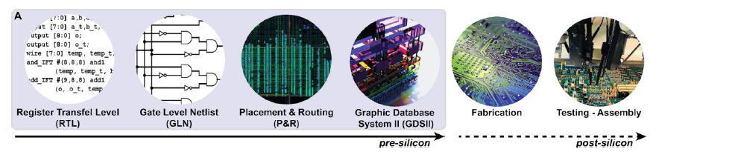
Trojans Insertion Analysis
Hardware are manufactured in basically six steps in industries -:
Register Transfer Level (RTL)
Gate Level Netlist (GLN)
Placement & Routing (P & R)
Graphic Database System II (GDSII)
Fabrication
Testing and Assembly
IC’s when fabricated are embedded with the malicious trojans which leaks the data through the covert channel like the AES encryption algorithm running on hardware may result in the leak of secret keys needed for the secure channel communication.
These Hardware Trojans (HT) are dormant until they are triggered via multiple activation mechanisms.

Slide 6
Possible Approaches towards the Problem
The possible solution approaches towards problem can be -:
Threat Modelling
Side-channel analysis
Reverse engineering
Machine learning-based approaches
Physical inspection
Understand the potential threats and attack vectors associated with hardware Trojans. This involves analyzing the different stages of IC design, fabrication, and assembly where malicious modifications can occur.
Use side-channel analysis techniques to detect anomalies in power consumption, electromagnetic radiation, or timing behavior of ICs. Hardware Trojans can cause variations in these parameters, which can be monitored and analyzed to identify potential malicious modifications.
Reverse engineer the ICs to analyze their internal structure, functionality, and potential presence of hardware Trojans. Techniques like fault injection, circuit extraction, and invasive probing can be employed for this purpose.
Utilize machine learning algorithms to develop detection models capable of identifying patterns associated with hardware Trojans. Training datasets can include both known good and Trojan-infected ICs to enable accurate classification.
Perform physical inspections, such as microscopic analysis, X-ray imaging, or scanning electron microscopy, to detect any physical alterations or anomalies in the ICs.

Slide 7
Machine Learning Based Approach
Machine Learning (ML) based solution to the problem of detection of hardware trojans is one of most formidable and practical approach towards the problem.
Other approaches are pretty time consuming and inefficient as compared to ML approach as in the ML approach machine is trained with the past data of the trojan affected as well trojan unaffected hardwares so whenever new data is fed into the machine it could easily guess whether that particular device is trojan affected or not.
ML Solution to the problem can be affective with the diverse dataset which contains all sorts of possible cases of the situation in the hardwares.

Slide 8
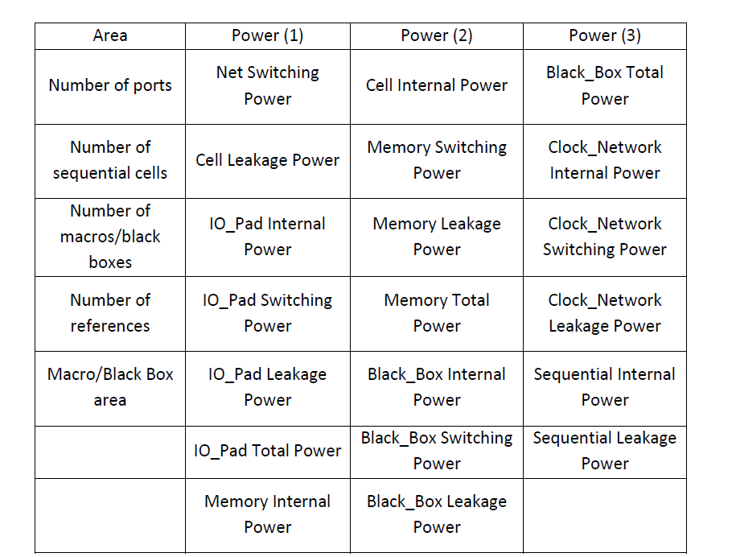
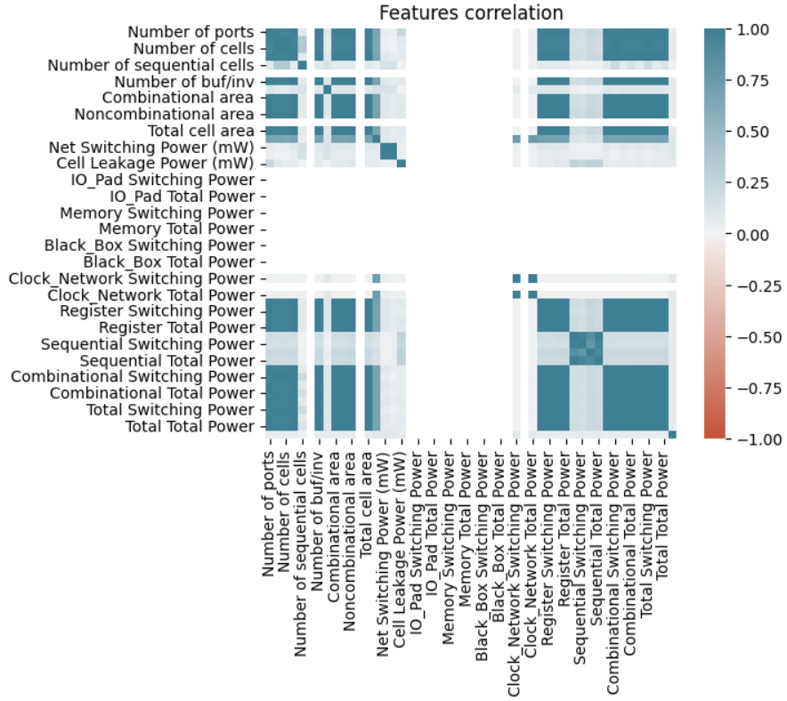
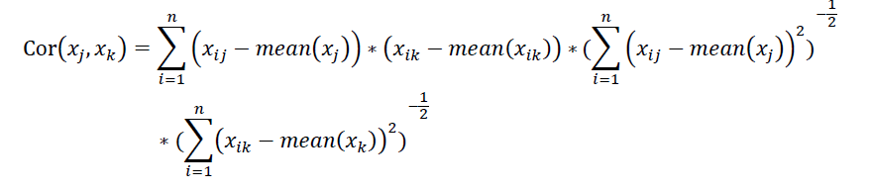
Dataset analysis
Dataset consists of more than 50 features other than the target name but the features with the very high Correlation ( > 95 % ) are removed .
After removing those features the left feature are 24 as shown in the figure..

Slide 9
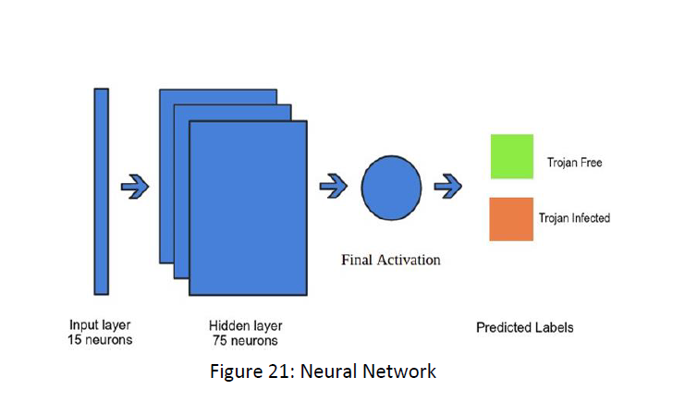
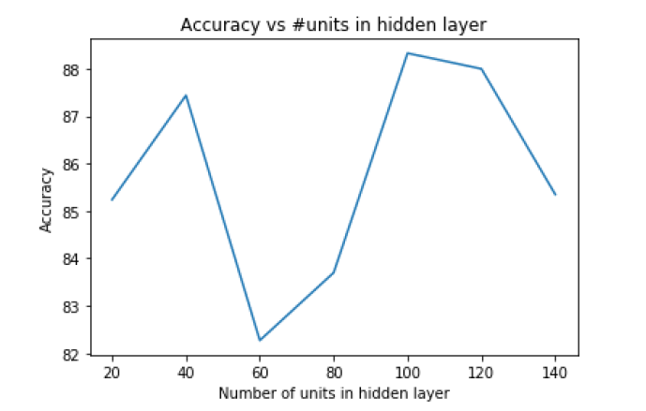
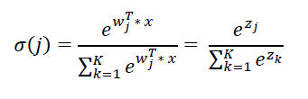
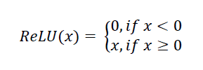
ML Algorithms Applied
Multi-Layer Perceptron(MLP)
To have a fully connected neural Network a sequential model of linear stack of 3 layers (input hidden and output ) layers is created.
Input Layer : with 15 neurons and RELU activation function
Hidden layer : with 100 neurons and RELU activation function
Output layer : with 2 neurons and SoftMax activation function
Here we can see that max accuracy is achieved when there are 100 neurons in the hidden layer from the graph of accuracy vs neurons in the hidden layer
The algo accuracy is 90.97 % and it took about 38 seconds to execute.

Slide 10
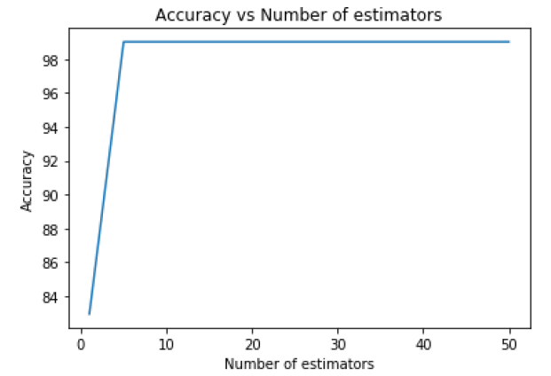
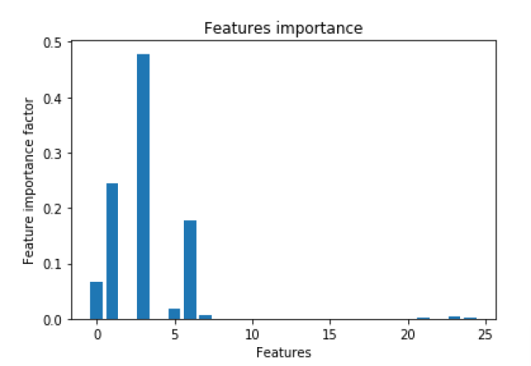
Random Forest Classification
Here in the RF algorithm I have used 5 estimators (number of trees in the forest) as we can see in the graph of accuracy vs no of estimators and further I have used 5 as the depth of each tree nodes.
This algorithm gave the fastest and the most accurate outcome on the testing or the validation dataset
It gave an accuracy of 99.01 % and it took about 0.01 seconds to execute
The feature importance for each of the feature can be calculated by knowing the information gain of that feature so according to that we have found that most of accuracy can be attained by the first 6 features values that are :
Number of ports
Number of combinational cells
Number of buffer or invertor cells.
Area occupied by buffer cells.
Cell Area.
Total dynamic power.

Slide 11

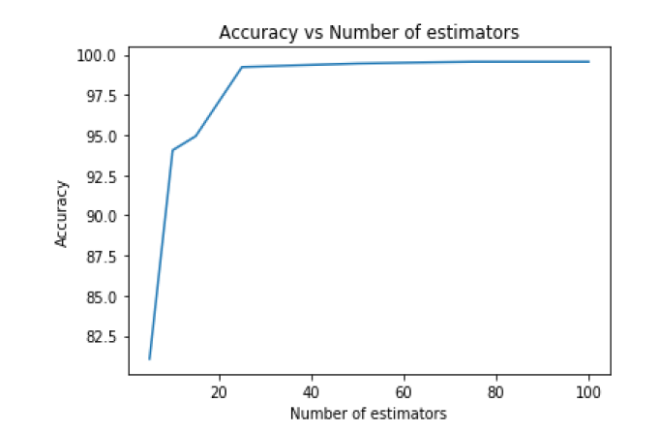
Support Vector Machine (SVM)
Gradient Boosting Classifier
SVM algorithm is giving a accuracy of nearly about 77-78%
Hyperparameters used here are :
C (Regularization constant) = 10
Gamma = 1
Kernel = RBF (Radial Basis Function)
This algo gives about 99% accuracy on the validation dataset
Here the max number of boosting stages used are 75 and learning rate is 0.1.
Logistic Regression (LR)
LR is giving an accuracy of about 70-71 % and it took about 0.02 seconds to execute.
Max iterations : 300
Liblinear class used.

Slide 12
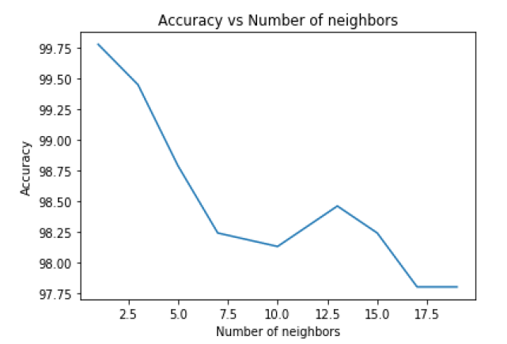
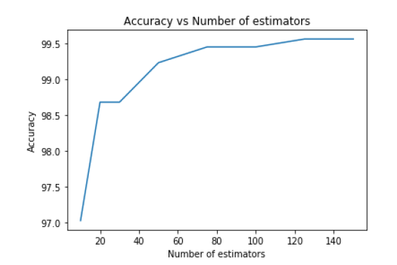
K – Nearest Neighbours (KNN)
XG Boost
Accuracy : 99.45 %
Execution time 100 ms.
Number of neighbours : 3
Accuracy : 99.56 %
Execution Time : 0.0 sec.
No of Estimators : 20

Slide 13
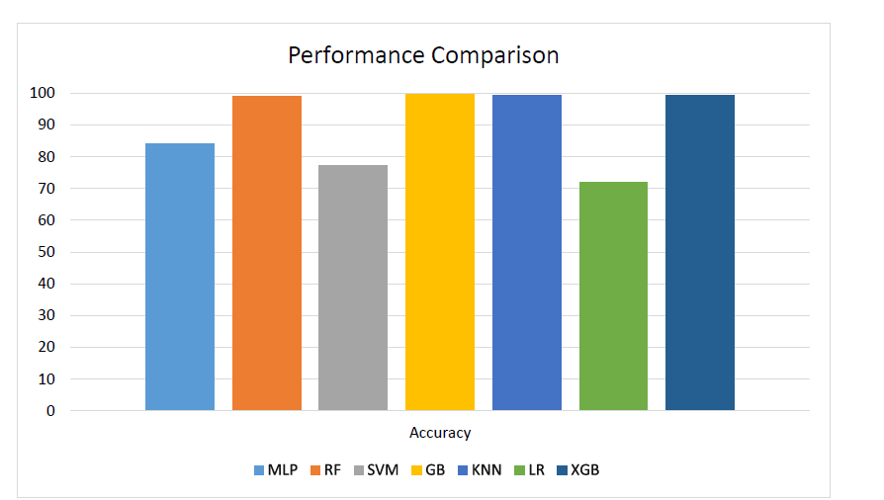

Comparative Study
Performance Comparison Of ML algorithms

Slide 14
Conclusion
The Proposed ML based solution is an efficient way for hardware Trojan Detection and classification technique via area and power features for GLN phase in IC’s.
The Highest accuracy obtained is from the GBC (Gradient Boosting Classifier) which resulted in nearly about 99.7% of the accuracy.
Also the best F1-score is also by the GBC which is nearly about 99.5 %.
Hardware Trojans problem solved with the AI can get up to great level of accuracy.

Slide 15

Future Improvements
Ability to predict the Circuit which is infected with the Trojan.
Working with the Real Time data input streams.
Last one is to improve the diversify and increase the sample size that is the size of dataset to improve the quality of solution.

Slide 16




Thank you
-- Suyash Bansal (B20CS076)

